Slide 1
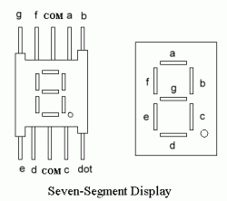
B
A
F
G
#1
#2
C
E
Dot
D

Slide 2
